Slide 1
Garbage collection in C
Team Members:
121008-Darpan Patel
121053- Shreya Gokani

Slide 2
What is Garbage Collection?
Garbage collection (GC) is a form of automatic memory management. It attempts to reclaim garbage, or memory occupied by objects that are no longer in use by the program. Garbage collection was invented by John McCarthy around 1959 to solve problems in Lisp.

Slide 3
Why?
Garbage collection frees the programmer from manually dealing with memory deallocation. As a result, certain categories of bugs are eliminated or substantially reduced:
Dangling pointer bugs, which occur when a piece of memory is freed while there are still pointers to it, and one of those pointers is dereferenced. By then the memory may have been reassigned to another use, with unpredictable results.
Double free bugs, which occur when the program tries to free a region of memory that has already been freed, and perhaps already been allocated again.
Certain kinds of memory leaks, in which a program fails to free memory occupied by objects that have become unreachable, which can lead to memory exhaustion. (Garbage collection typically does not deal with the unbounded accumulation of data that is reachable, but that will actually not be used by the program.)
Efficient implementations of persistent data structures

Slide 4
Implementation in Java
In java, garbage means unreferenced objects.
In java GC is performed automatically. So, java provides better memory management than C or C++ as we need to use free() command in C and delete() I C++.
Example:
public class TestGarbage1
{ public void finalize()
{ System.out.println("object is garbage collected"); }
public static void main(String args[])
{ TestGarbage1 s1=new TestGarbage1();
TestGarbage1 s2=new TestGarbage1();
s1=null;
s2=null;
System.gc(); } }

Slide 5
Our Goal
Make reclaiming memory easy for programmer.
Minimizing the amount of wasted memory at all times.
Make memory allocation dynamic and make garbage collection run in the background.

Slide 6
Algorithms Available
Cleanup At The End: aka No GC
Reference Counting Collector
Mark-sweep Collector
Copying Collector
Mark-Compact collector
Generational collector

Slide 7
Mark-Sweep Algorithm
The earliest and most basic garbage collection algorithm
It is a stop-the world collector
In mark-sweep, each object has a “mark-bit”.
It operates in time linear in the size of the heap (i.e. O(N)).
The basic functioning of our garbage collector (Mark-Sweep) consists, abstractly speaking of two phases.
Distinguishing the live objects from the garbage or garbage detection.
Reclaiming the garbage objects storage so that the running program can use it or garbage collection.

Slide 8
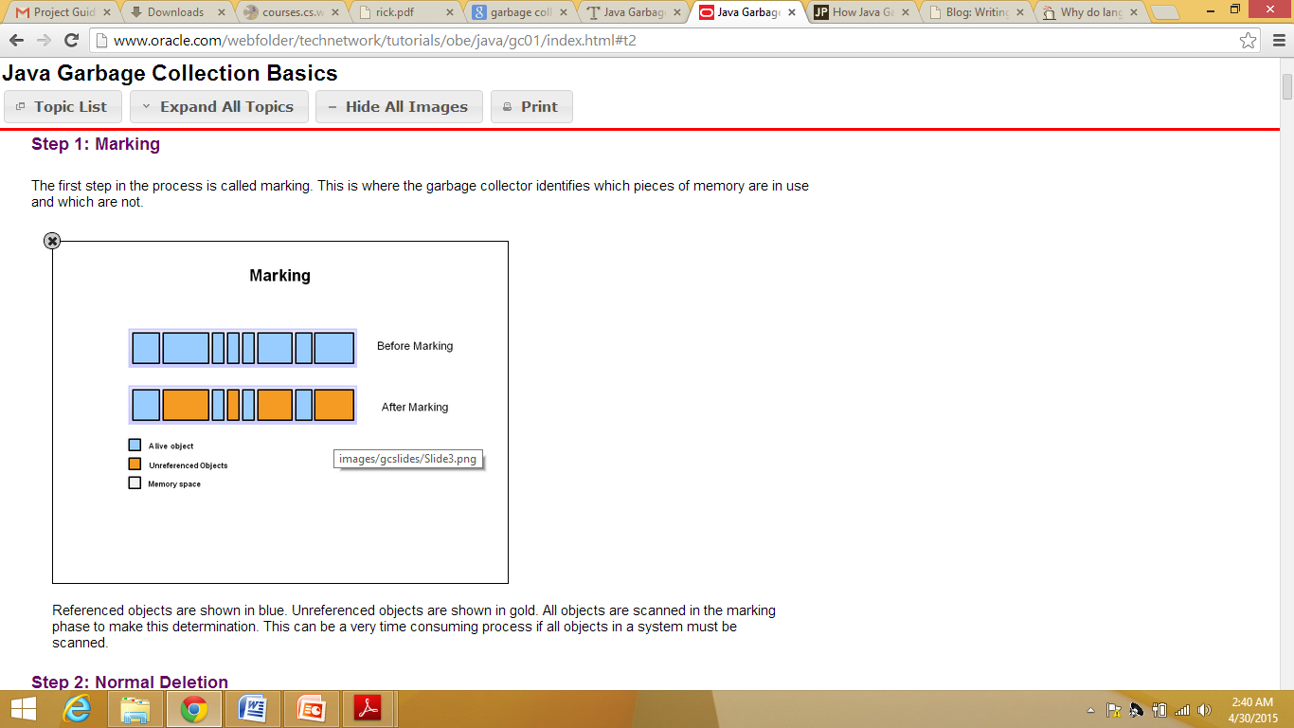
Mark-Sweep (Marking)

Slide 9
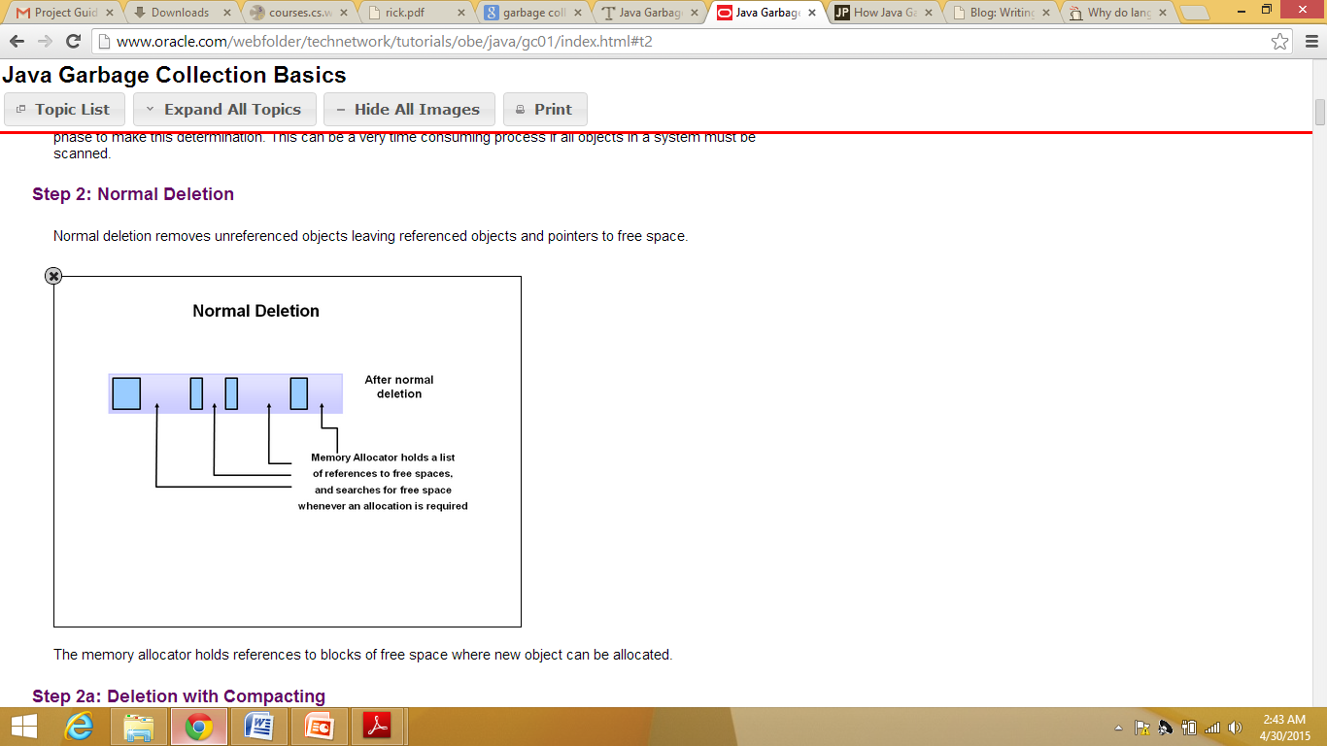
Mark-Sweep(sweeping)

Slide 10
Implementation in c
Rather than using malloc and free to obtain and reclaim memory, it is possible to link in a garbage collector and allow it to reclaim unused memory automatically.
For this, we can replace malloc with the garbage collector's allocator and free with a do- nothing subroutine.

Slide 11
Conclusion
C is not compatible for kernel level implementation but research are going on to implement GC in C.
Our garbage collection routine currently pauses the program when it runs.
C language provides very little help in writing correct, bug free code. It doesn’t have any standard for memory management.

Slide 12
References
http://programmers.stackexchange.com/questions/113177/why-do-languages-such-as-c-and-c-not-have-garbage-collection-while-java-does
http://web.engr.illinois.edu/~maplant2/gc.html
file:///C:/Users/sunil/Downloads/rick.pdf
http://www.cs.utah.edu/~regehr/papers/ismm15-rafkind.pdf
http://www.codeproject.com/Articles/31747/Conservative-Garbage-Collector-for-C
http://www.linuxjournal.com/article/6679?page=0,1

